Slide 1

The sıms
Se 350 – game desıgn
Naz tekınalp
20160602033

Slide 2

The sıms
The Sims is a series of life simulation video games developed by Maxis and published by Electronic Arts. It is one of the best-selling video games series of all time.

Slide 3

The sıms

Slide 4

Core loop
Manage your house
Daily activities
Educate your Sim or earn money
Improve your other relationships with other Sims

Slide 5
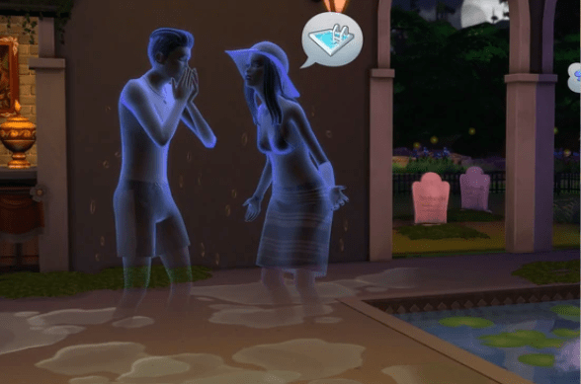
1. CHALLENGE
DRAMATIC ELEMENTS
Money is one of the most important challenge
Sim’s mood: Sim’s mood effect the quality of his\her life
Mortality
Ghost (dead people)

Slide 6
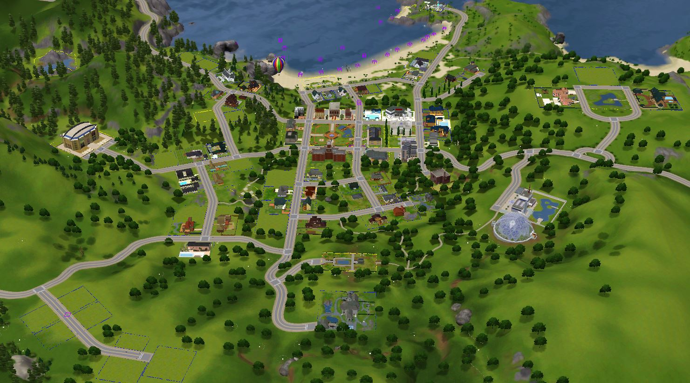
2. pLAY
Create a Sim and family
Construct a house
Having an imaginary life – get job, go to school
Exploring the world, adventuring
Having the most money among all players
Fun - Doesn’t take the game seriously

Slide 7
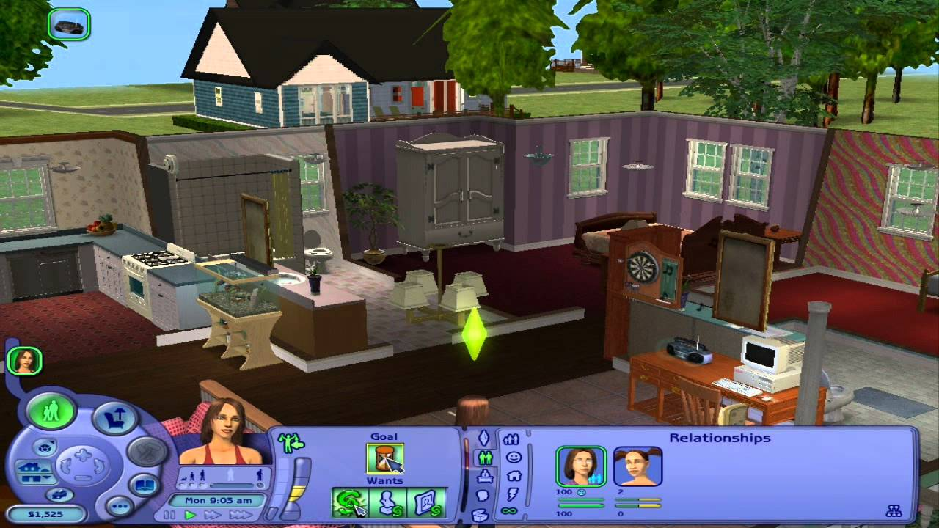
3. Premise
Players can create avatars and mess with their lives
Creating your own life, that makes it more valuable
involving characters with dramatic motivations

Slide 8
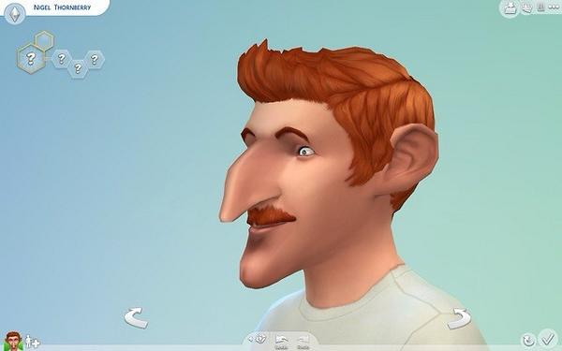
4. Character
Gamers create their own world living as a character.
Every character that you create by yourself is protagonist.
Every character in sims that you have created is unique.

Slide 9
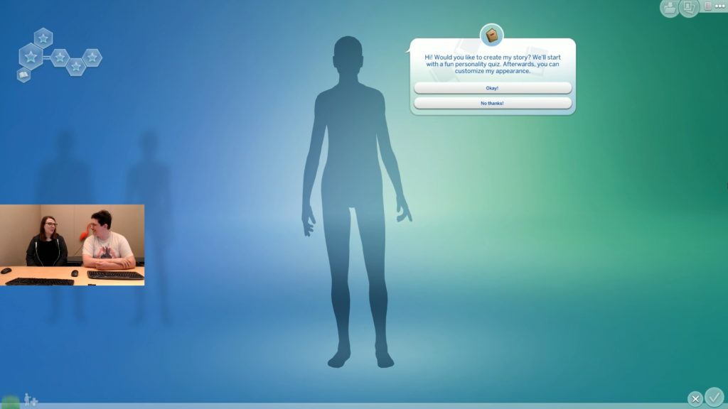
5. Story
Every Sim creates their own story. So there’s no story behind.
In the Sims 4, creating stories option is added to the game.

Slide 10
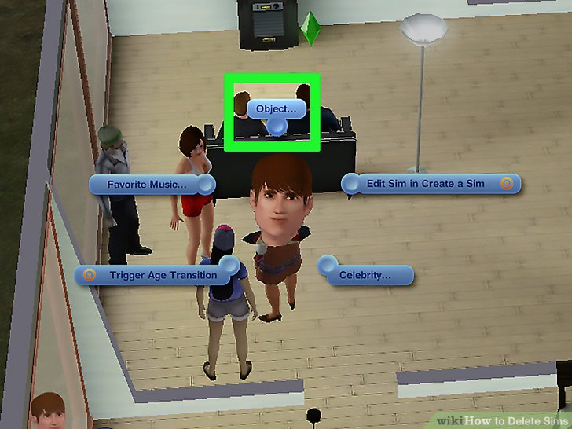
1. players
formal ELEMENTS
The Sims is Single player versus game. - single player competes against a game system

Slide 11
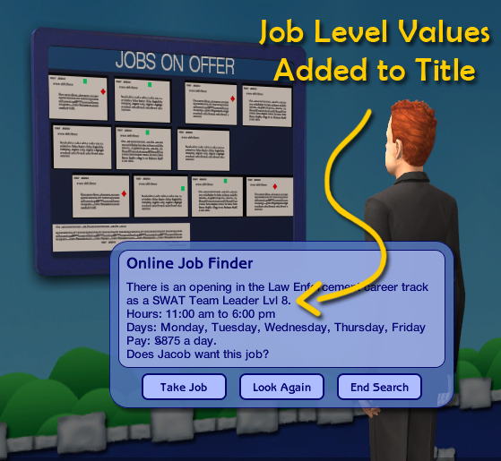
2. Objectıves
Organizing the Sim’s time and helping them to reach their personal goal
Go to school
Start to a job
Earn Money
Buy a house / furniture
Construction

Slide 12
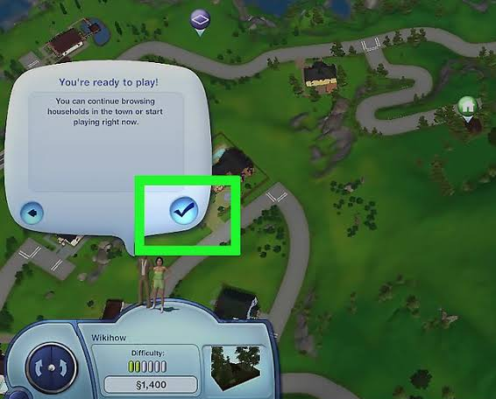
3. procedures
Starting Action: Create a sim
Progression Action: Have a family and live in a house
Resolving Action: If your Sim dies, game ends for that Sim.

Slide 13
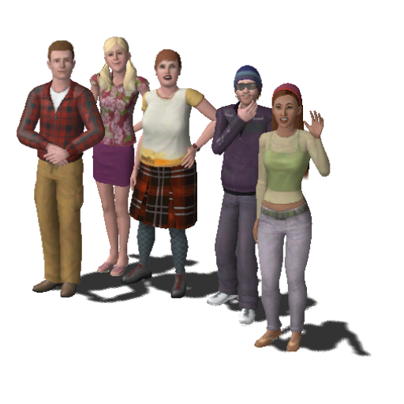
4. rules
Max. 8 Sims can be in one household
Once you've created your Sim, you can’t edit your Sim’s features.
Sims can now die from emotion.
Sims can also die from exhaustion
Children can’t live in a house without Adults.
Building home for your Sim is required.
“Every game is its rules — for they are what define it.” (David Parlett)

Slide 14
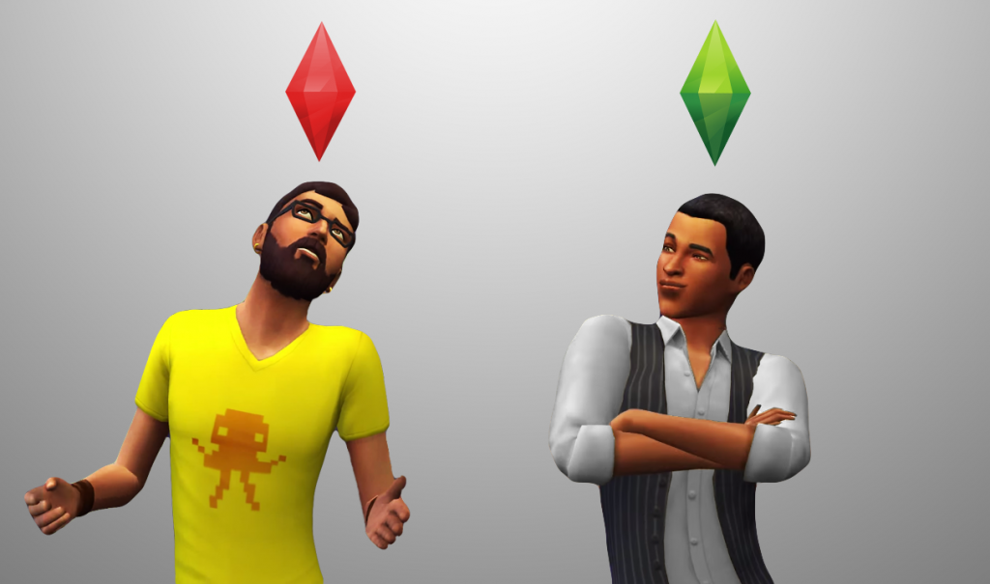
5. resources
Time
Money
Health
Mortality
Energy – mood

Slide 15
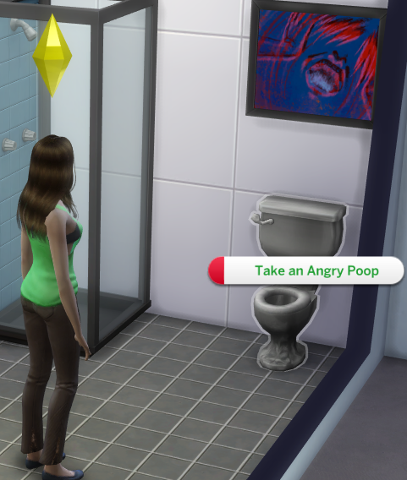
6. conflıct
Make Sims’ happy
Make them alive
Take care of Sims’s personal needs – food, toilet etc

Slide 16
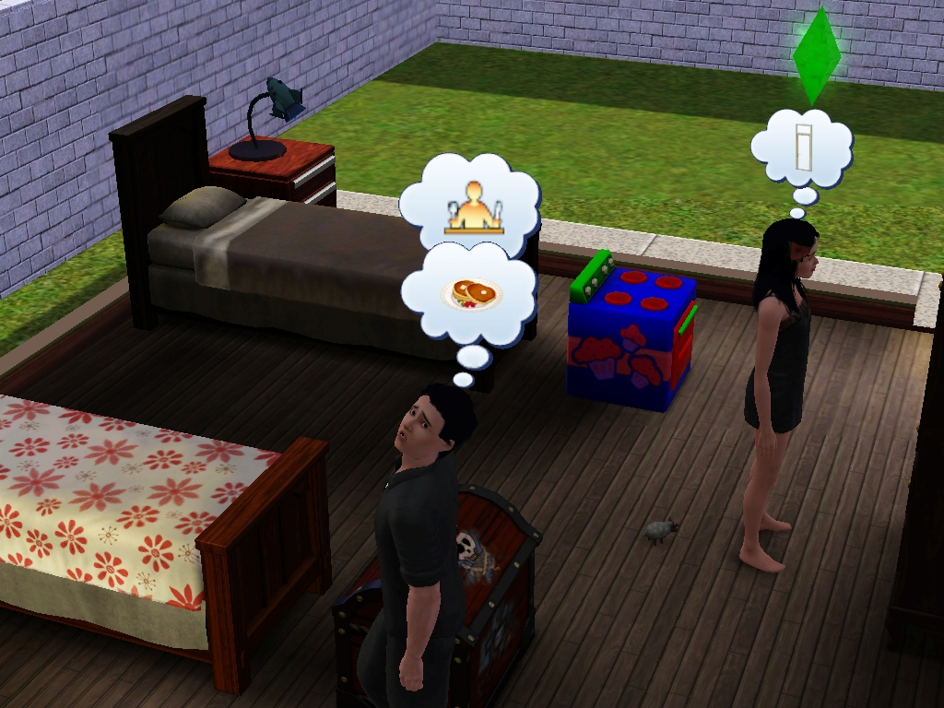
7. boundarıes
Game area is limited in each city
Gender boundaries – girl or boy
Only 8 Sims per household
Children can’t live without at least 1 adult

Slide 17
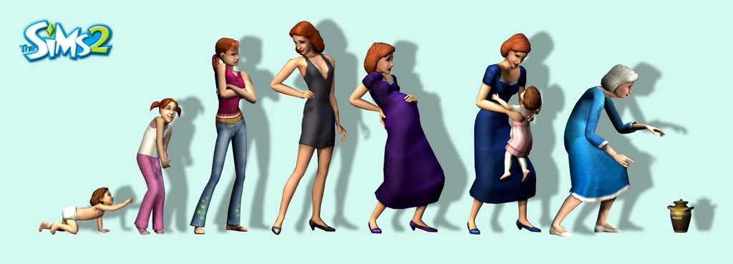
8. outcome
You create your own character. For each sim, you watch them to live and die.
There’s no beginning or end of the game.
Creating of every sim is a new game by itself.

Slide 18
Thank you for lıstenıng

